Slide 1
Supporting Literacy development at home before starting School
February 2023

Slide 2
How can I help my child at home?
This presentation will give you support and ideas on:
Language – Talking
Literacy – Reading and Writing

Slide 3
Pre Reading Skills
​It's important to remember that learning to read involves various different skills. There are five essential components of reading…
Phonemic awareness
Phonics
Vocabulary
Reading comprehension
Fluency
Notes:
1. the ability to hear and manipulate the different sounds in words
2. recognising the connection between letters and the sounds they make
3. understanding the meaning of words, their definitions, and their context
4. understand the meaning of text, both in storybooks and information books
5. the ability to read aloud with speed, understanding and accuracy

Slide 4
Help them to see that reading is fun, interesting and important​
Sharing a story-Snuggle up and read stories together everyday.
Environmental Print
Create your own stories together
Notes:
Sharing a story- Encourage your child to predict what might happen next and discuss what happened in the story when you have finished reading it. Book reviews are great for encouraging conversations about the child's likes and dislikes and explaining what Authors and Illustrators do. When reading talk about interesting or unusual words and what is happening in the book. If your child likes a challenge, ask if they can hear any sounds that sound the same or rhyme. Can they find any words that begin with the same letters.
Environmental Print- Look at words, signs and labels when out and about for example road signs, street names and shop names. Ask your child if they can see any letters that are in their name. ​
Create your own stories- Have fun using your imagination by making your own stories together. Encourage the children to scribe what they say or help you to copy as you write. Your child could even draw pictures to support what you write. Add new and interesting words to the story to develop your child’s vocabulary. For example if your child said ‘the dog was happy,’ you could encourage them to think of another word that means happy such as ‘ecstatic, cheerful, joy full, thrilled.

Slide 5
More reading opportunities that can be provided at home​
Library visits
Songs and nursery rhymes
Patience
Notes:
Library visits are fun and a good way of getting your child interested in nonfiction books. At the library, find books on your child’s favourite topics.
Children's songs and nursery rhymes aren't just a lot of fun—the rhyme and rhythm help kids to hear the sounds and syllables in words, which helps them learn to read. A good way to build phonemic awareness (one of the most important skills in learning to read) is to clap rhythmically together and recite songs together.
Every child learns at his or her own pace, so always remember the single most important thing you can do is to make it enjoyable. By reading regularly, mixing things up with the activities you choose, and letting your child pick out their own books occasionally, you'll instil an early love of reading and give them the best chance at reading successfully in no time.

Slide 6
https://www.youtube.com/watch?v=nSEv8ptOxxo
Getting Ready To Read…

Slide 7
Pre Writing Skills
Pre-writing skills are the fundamental skills children need to develop before they are able to write. Some of the key skills for pre-writing include:​
Hand and finger strength ​
Crossing the mid-line​
Pencil grasp​
Hand eye coordination​
Hand dominance ​
Visual perception
Hand and finger strength
Notes:
It is important to know that teachers are not looking for your child to be able to write before starting school so don’t worry about this. If they can, that's fantastic. If not there are a few things you can do support their pre-writing skills at home.
Crossing the midline is
Pencil grasp
Hand eye co-ordination
Hand dominance

Slide 8
How to support and develop pre-writing skills at home
Hand & finger strength Crossing the midline Visual Perception
Popping bubble wrap Dressing themselves Jigsaws
Rolling out playdough Playing Simon Says Playing I Spy
Using clothes pegs Washing the car Lego and other construction toys
Squeezing water sprays
Notes:
Supporting your child to learn to put their jacket, shoes, hats, gloves etc on themselves before going to school is a key skill and will help your child to feel more independent.

Slide 9
How to develop your child's pre writing skills at home
Explore letters and sounds together
Have fun with letters
Take letters outside
Notes:
For example looking at the letter A, this makes the sound ‘ah’. Can you child think of any words that begin with this sound and so on. Explore the sounds and letters in their first name. Playing I Spy is a good game for learning sounds and letters. For example I spy with my little eye something beginning with S.
Children enjoy copying words out onto paper. Write your child’s name and have him copy it himself with alphabet stamps, stickers, or magnets. Encourage him to “write” his own words using the letters. Your child will write letters backwards, spell seemingly randomly, and may hold his marker strangely — it’s “all good” at this age when a child wants to communicate in writing of any kind.
Encourage your child to make letters out of Play Doh or draw them into sand, clay or shaving foam. The next time you are out in the park, or at the beach, or in the snow, use your surroundings to play with letters. Take turns writing letters in the snow, dirt, or sand.

Slide 10
More ways to develop pre writing skills at home
Write shopping lists together
Provide opportunities for your child to write their name
Use various materials to keep your child interested and engaged
Notes:
For example of birthday cards or party invitations.
Including pencils, pens, crayons or painting

Slide 11
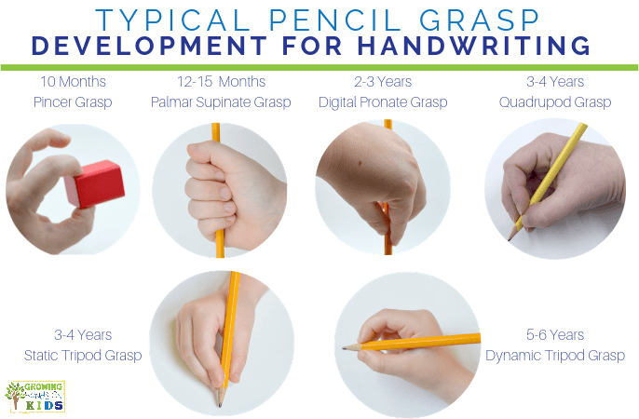
Did you know there are different stages to being able to hold a pencil…
Notes:
It is important to remember here that all children are individuals and develop at different rates.

